Slide 1
Processing Pipeline for Serial Awakening Data

Slide 2
PreProcessing
Find DINS closest to awakening time
Mark difference between experimenter and DIN difference
Extract 5 minutes before each awakening
Mark NREM awakenings from those that are aligned/sleep scored
5 minutes did NOT contain ANY epochs marked as REM
Get “INSIDE 185” Channels
High-pass filter (1 Hz) data
Clean Line Noise - Pop_Clean_Line (60 Hz)
Trim 1 second from beginning/end of data
Concatenate NREM awakenings
Remove bad channels (visually)
Average reference data

Slide 3
Runica w/ pca option, correcting rank for bad channels and average referencing
Full rank
Remove ica components with aide of ICLabel

Slide 4
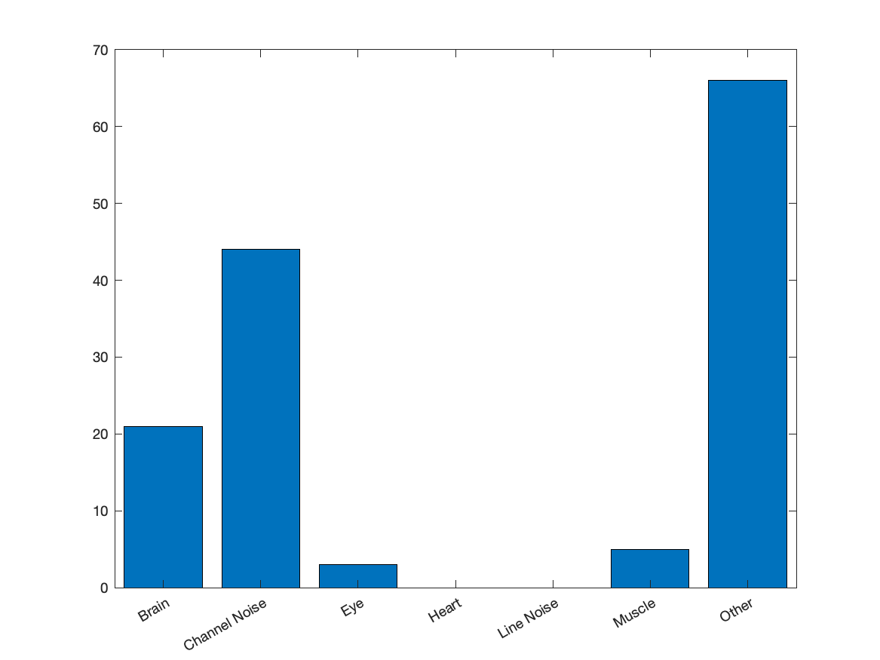
Subject 2079

Slide 5
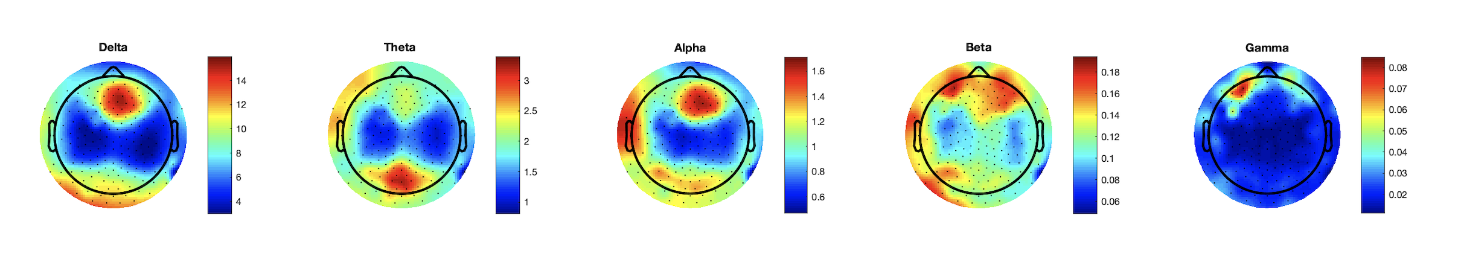
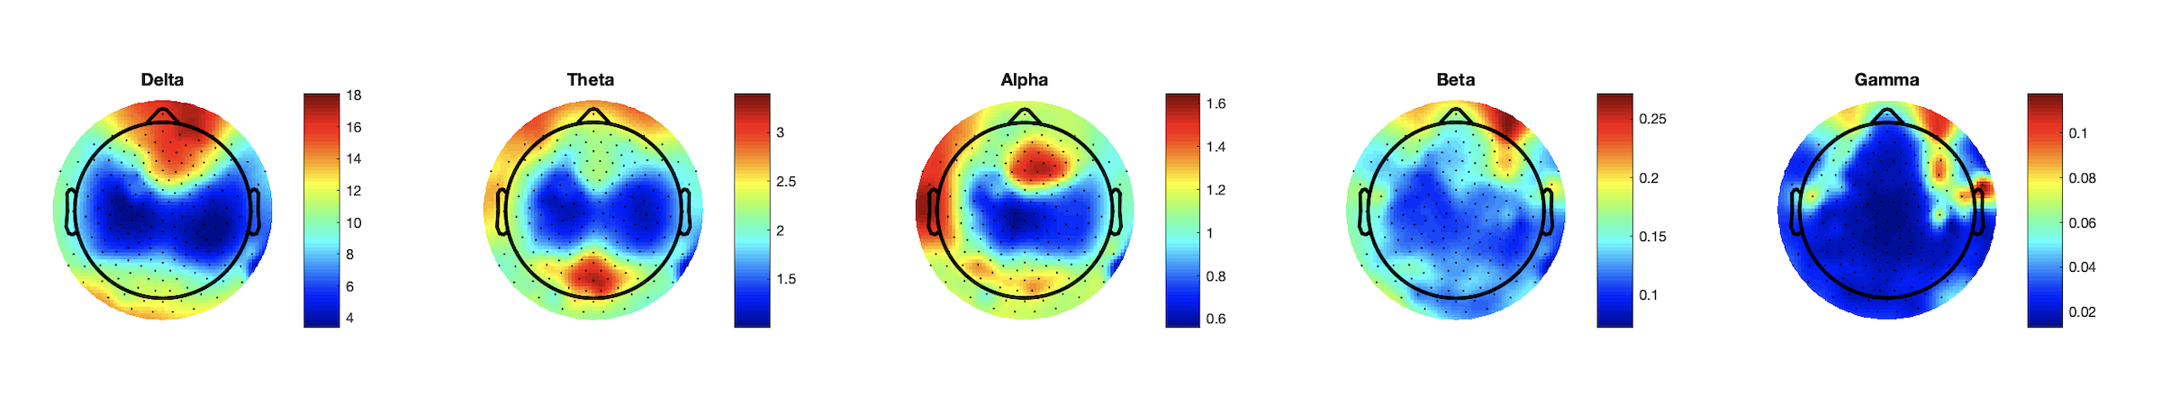
Subject 2079 (Awakening 1 )
cleaned
uncleaned

Slide 6
Subject 2079 (Awakening 3 )
cleaned
uncleaned

Slide 7
Subject 2079 (Awakening 4 )
cleaned
uncleaned

Slide 8
Subject 2079 (Awakening 5 )
cleaned
uncleaned

Slide 9
Subject 2079 (Awakening 6 )
cleaned
uncleaned

Slide 10
Subject 2079 (Awakening 7 )
cleaned
uncleaned

Slide 11
Subject 2079 (Awakening 9)
cleaned
uncleaned

Slide 12
Subject 2079 (Awakening 11)
cleaned
uncleaned

Slide 13
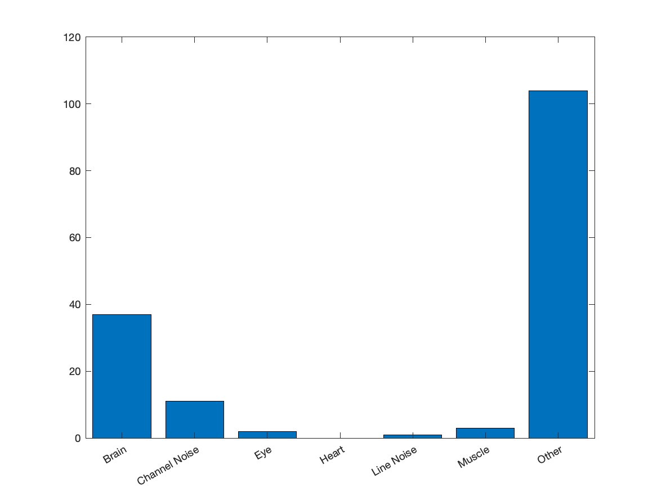
Subject 2091

Slide 14
Subject 2091 (Awakening-1)
cleaned
uncleaned

Slide 15
Subject 2091 (Awakening 2)
cleaned
uncleaned

Slide 16
Subject 2091 (Awakening 5)
cleaned
uncleaned

